Slide 1
Extend Diffusion-TS to Federated Learning
Chenrui Fan
Zhiwen Soi

Slide 2
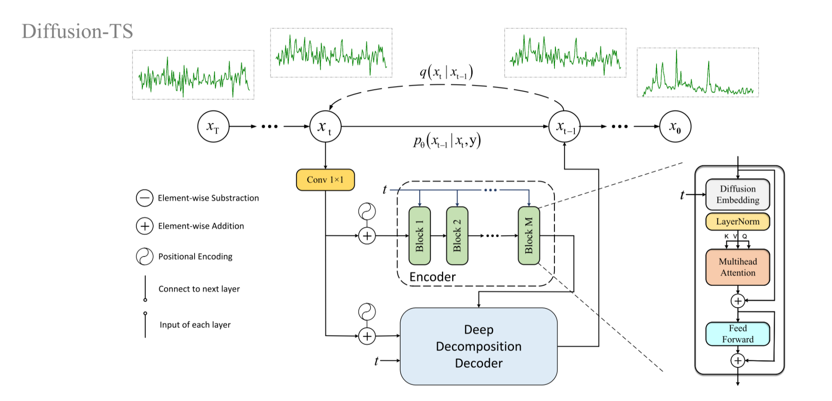
Diffusion-TS

Slide 3
1. HFL
Diffusion-TS with
Horizontal Federated Learning

Slide 4
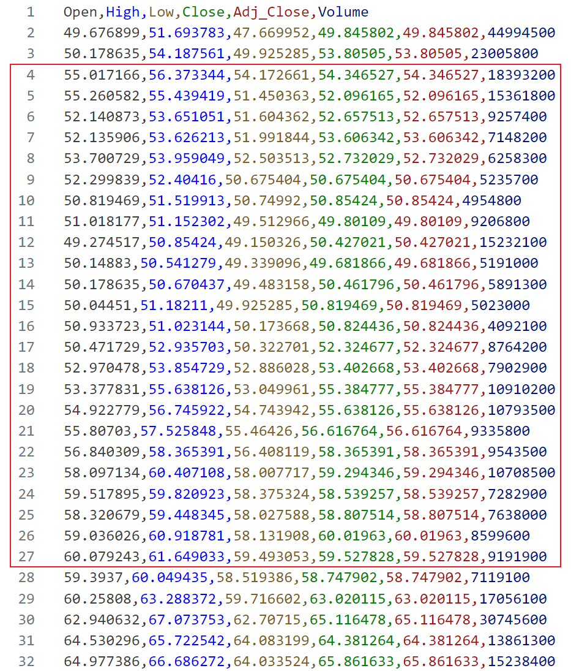
Dataset Split
Unlike common tabular data, the smallest unit of the time series dataset is not a row but a sequence which length is determined by the Window Size. In Diffusion-TS, Window Size equal to 24, this is changeable.

Slide 5
IID or NIID Split
We can divide these sequences of the same length in sequential order, or we can randomly intercept sequences of length 24 from the dataset.
When we need IID subsets, we can either disrupt the dataset or use randomly intercepted sequences;
When we need NIID subsets, we can use sequences divided in sequential order and assign them to each client in turn.

Slide 6
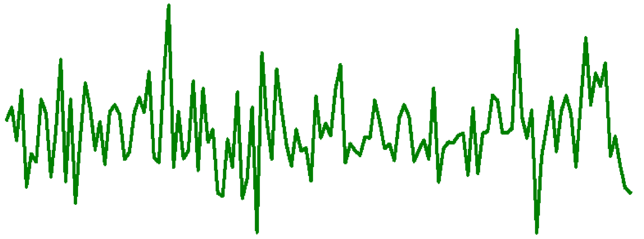
IID or NIID Split

Slide 7
Divide in order
S1
S2
S3
S4
S5
S6
S7
S8

Slide 8
random choose or shuffle
S1
S6
S5
S2
S7
S3
S4
S8

Slide 9
IID or NIID Split
Another idea is to use a pretrained model to give each segmented sequence a label (up, down, maintain). Then use this label for iid and niid segmentation.
up

Slide 10
HFL
Our main goal on HFL is to:
1. to see whether we can achieve the same results as IID with the NIID dataset.
2. deal with each client not being aligned on the row (timeline).
3. test the maximum number of clients we can support with guaranteed performance.

Slide 11
2. VFL
Make SiloFuse work with Time Series

Slide 12
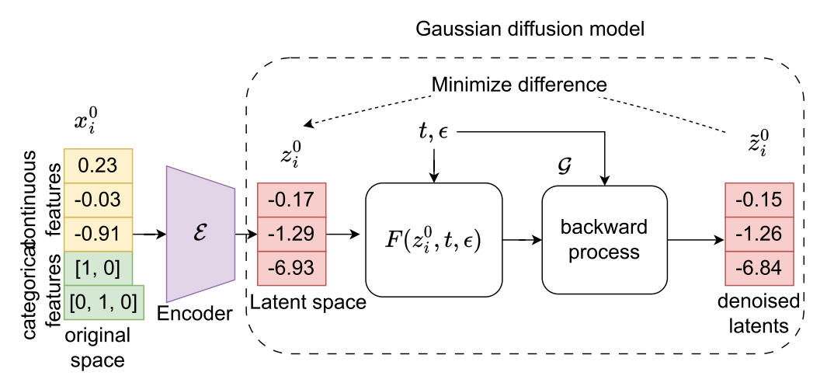
SiloFuse

Slide 13
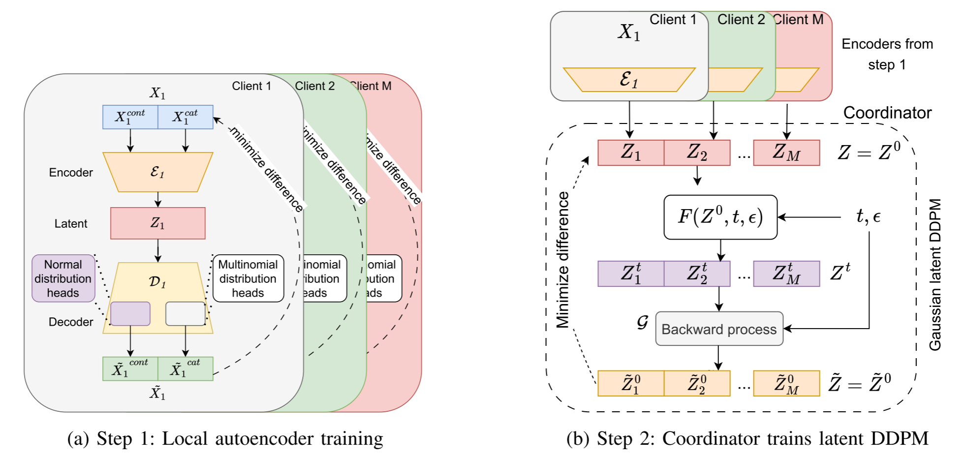
SiloFuse

Slide 14
SiloFuse
Advantages:
Trains models collaboratively by encoding original features into a latent space, ensuring confidentiality while avoiding the high costs of mainstream one-hot encoding.
Introduce a stacked training paradigm to decouple the training of autoencoders and the diffusion generator. Minimizes communication costs by transmitting latent features only once and avoids the risks of gradient leakage attacks.
Centralizing latent features preserves cross-silo links while thwarting data reconstruction under vertically partitioned synthesis.
Shortages:
SiloFuse deals with tabular data, there is no sequential correlation between samples. With time series data, the auto encoders need to preserve this sequential correlation as well because time is an important factor.

Slide 15
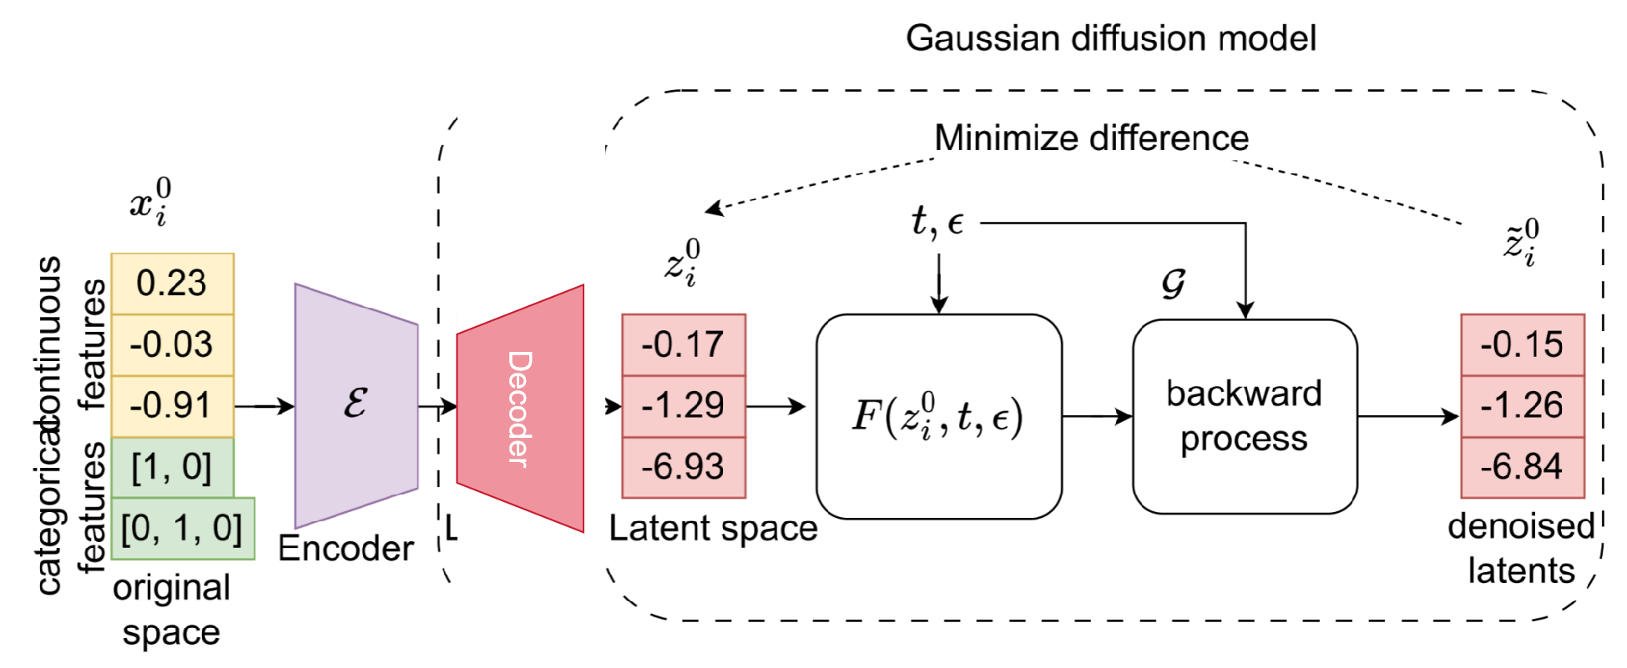
How to preserve time series information?
Idea 1: Try to make the Server to get the same data as the original so that the Diffusion-TS doesn't lose much of the information it gets.
Problem: the server is not the appropriate party to hold the decoder for Data Privacy problem.

Slide 16
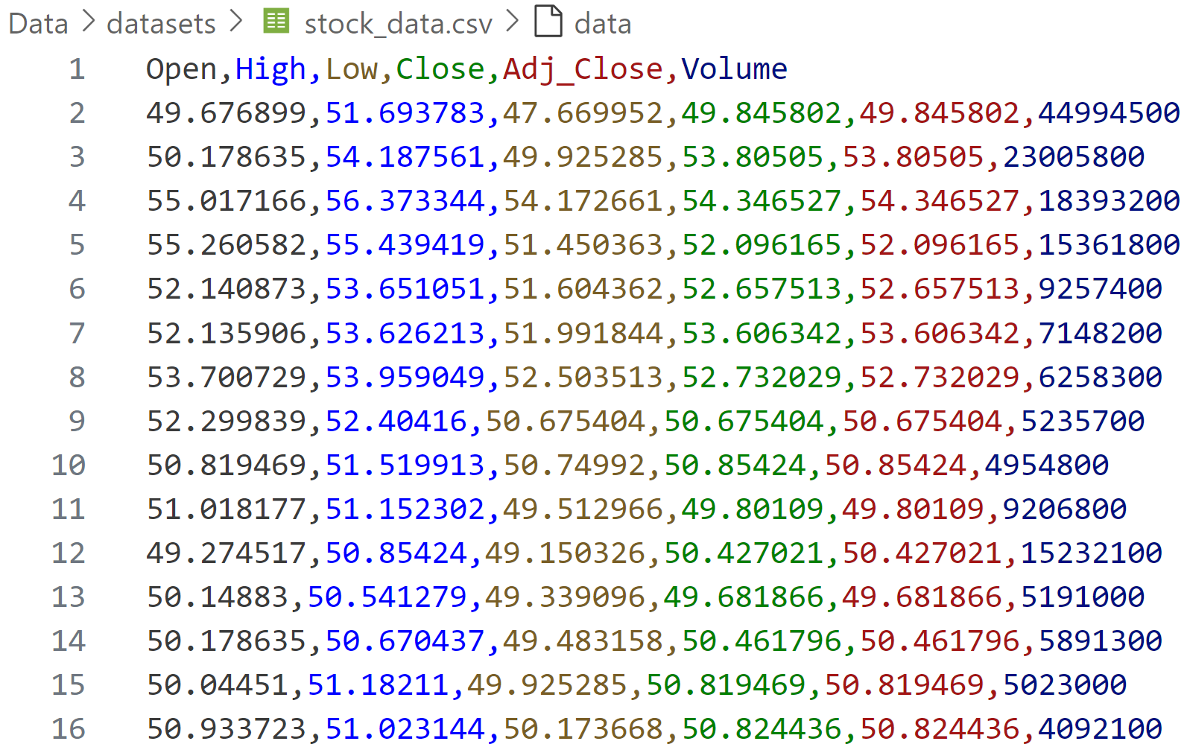
How to preserve time series information?
Idea 2: Training Diffusion-TS with latent features.
But how can we get time-sequence-guaranteed latent features?
Instead of VAE or simple 3-layer MLP, try other model like RNN and so on that good at time series.

Slide 17
VFL
Our main goal on VFL is to:
1. extend SiloFuse to be able to handle time series dataset.
2. make VFL-based Diffusion-TS's result as good as only using Diffusion-TS(how to preserve time information)

Slide 18
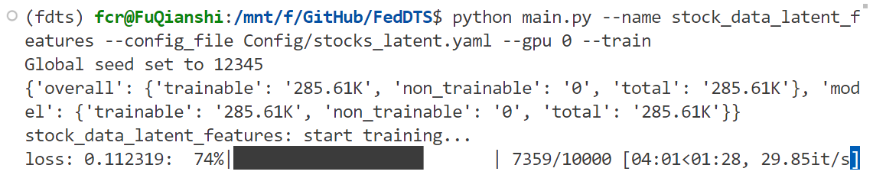
Current progress
1. Finish reading several papers, including SiloFuse and Diffusion-TS;
2. Successfully run the code of Diffusion-TS;
3. Implemented SiloFuse’s idea on Diffusion-TS.

